Slide 1
Fault-network inversions of geologic and geodetic data for regional seismic hazard analysis
Application to China
Richard Styron, Thomas Chartier, Marco Pagani
Taiwan, 21 December 2021
Notes:
Hi everyone, thanks for watching my talk, and I’d like to thank my coathors Thomas Chartier and Marco Pagani. Today I will be talking about some advancements we are making in earthquake occurrence modeling at GEM, where we use joint geologic-geodetic block modeling to find slip rates for all faults in a fault network. The first major application of these techniques is in a new PSHA model we are developing for China.

Slide 2
Block models for fault network analysis
The problem:
Most faults in a region are poorly characterized
Some mapping exists
Slip rates only on major structures (~10-20% of faults in a region)
Geologic slip rates only apply to single structures
No way to use strain budget, patterns from geodesy
The solution: Geologic-geodetic block models
Efficiently estimate the slip rates for all faults in a region
Geologic mapping and slip rates integrated with GNSS and InSAR data
Block models adhere to strain budget, fault network constraints (i.e. kinematic consistency)
Notes:
Though fault sources are necessary components for modern PSHA, including faults in the model is challenging. The biggest problem is that faults are usually poorly characterized. Though some mapping of active faults exists almost everywhere on Earth, only the most prominent structures have geologic slip rate estimates. This is only 10-20% of faults in a region. Additionally, geologic slip rates only apply to the fault that is studied and it is not typically possible to generalize them to other faults in an area.
Block models provide a good solution to all of these problems. We use block models with rates derived from joint inversions of geologic fault slip rate data with GNSS and InSAR data. This technique lets us efficiently find the maximum likelihood slip rates for all faults in a fault network or region, with perfect internal consistency. Block models adhere to strain budgets and fault network constraints, so that any piece of velocity or slip rate data or other information such as fault geometry and connectivity helps find the rates for deformation on any other fault in the system.

Slide 3
China block model
Large, data-rich:
~300 blocks
~1000 faults
~150 geologic slip rates
~3000 GNSS velocities
Notes:
Here is the block model. The faults are in black. The block boundaries are in orange. This is a very large area, mapped at fairly high resolution, and the model encompasses a lot of data. There are about 1000 faults separating 300 blocks. The inversion uses about 150 geologic slip rates and over 3000 GNSS velocities.

Slide 4
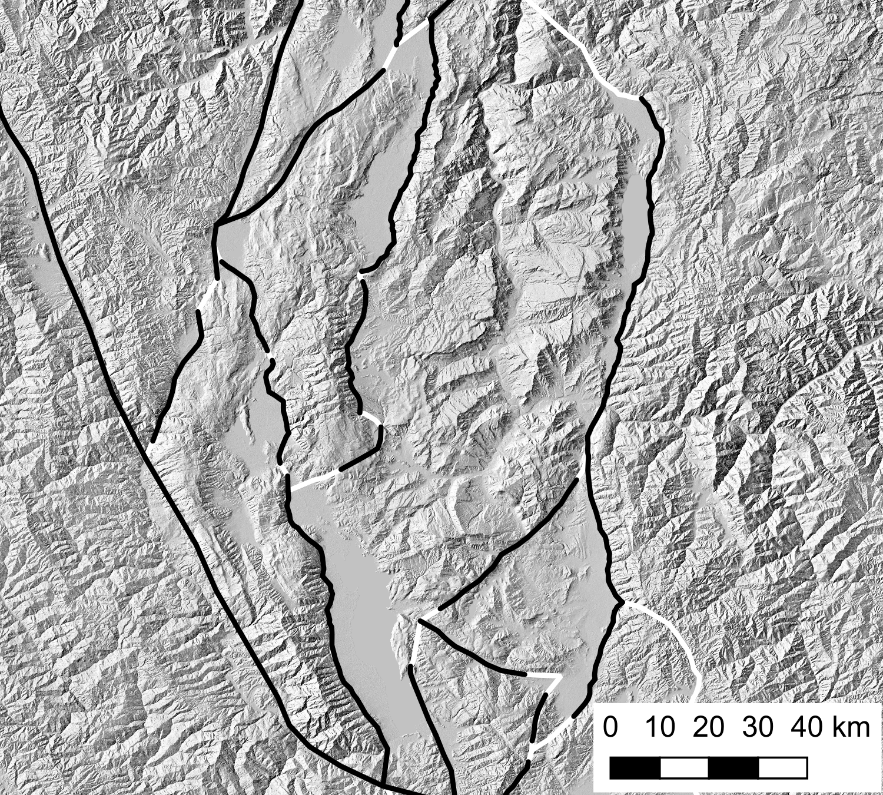
High resolution
Faults are mapped at ~1:100,000 (same or higher resolution than most hazard source faults)
Some simplifications of branches, splays
Goal is to include all faults of seismogenic concern
Fault geometry in blocks same as in hazard models
Notes:
All of the faults in the block model were mapped for this project, at the same time as the blocks, based on existing mapping as well as new interpretations. The mapping is pretty high resolution, ideally about 1:100,000, but in some cases it is higher where the imagery is good and in some cases it’s more coarse, where the imagery is poor. This map is of a fault system near Dali, Yunnan, and it shows the resolution of the faults and blocks in tectonically complex areas.
In some cases, simplification of fault branches and splays has been performed, but the idea is that all independent faults of seismogenic concern are included in the model. Fault segmentation is only considered on the basis of geometry, and multifault ruptures are allowed in the hazard model. The fault geometry as mapped for the block models is also identical to the geometry in the seismic source model.

Slide 5
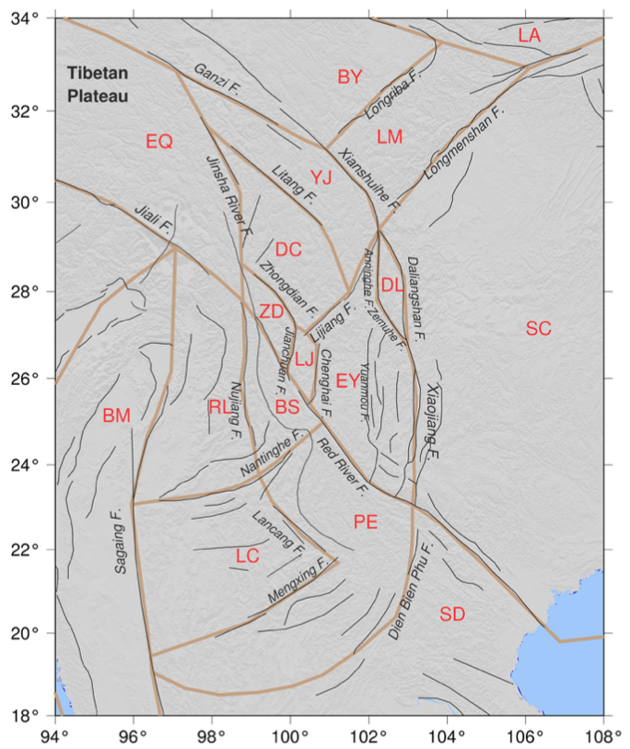
Comprehensive
17 blocks
94 blocks
Wang et al., 2021 JGR
Notes:
The block model is also very comprehensive—as I said, the goal is to include all faults of seismogenic concern. This means that the number of blocks has to be much higher than in the standard approaches. The figure on the left is from a very recent paper, by Wang and others, and for southeastern Tibet and northern Indochina it includes 17 separate blocks. Our block model contains 94 blocks in the same area. Having too few blocks causes all of the strain to be localized onto a few structures, which increases the seismic hazard near those structures and decreases it away from the structures. It’s better to make the blocks smaller and more numerous, so that the distribution of strain will be most accurate, but this requires more time and expertise during the mapping, as well as a high density of fault slip rates and GNSS velocities, so it’s not possible everywhere on earth.

Slide 6
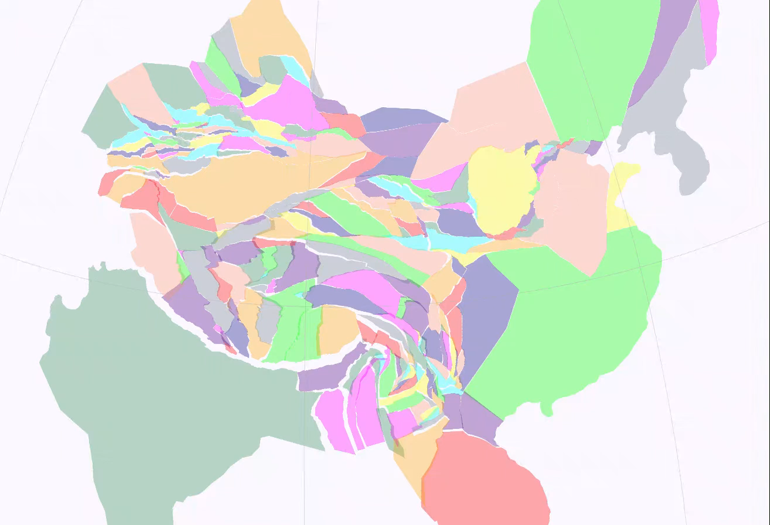
Visualize block motions in time
Notes:
One of the most informative and fun parts of this is taking the instantaneous block motions produced by the block inversion and extrapolating them forward and back in time by several million years. This allows us to visualize the modern deformation much better than simply by looking at the slip rates. I would not call this accurate paleogeography because I do not expect the rates to be the same over millions of years but it is helpful nonetheless. It is also a very good way of finding problems in the block models.

Slide 7
Block modeling results
Strike slip, dip slip rates for ~1000 faults
Generally good agreement between geologic rates and block model estimates
Block model slip rate uncertainties are smaller than for most geologic studies
Notes:
We can compare the geologic slip rates used in the inversion to the model results. Here we show dextral rates, and negative rates are sinistral. The observed rates are on the x axis, in millimeters per year, and the modeled rates are on the y axis. The rates generally agree fairly well, though some of the very high geologic slip rates are not matched by the modeling. This can be due to errors in the geologic slip rate estimates, such as by the wrong correlation of offset features, or by errors in the block model data or geometry. The uncertainties are also much lower for the block model, because of how the fault network and strain budget constraints combine information and reduce uncertainties.

Slide 8
Block modeling results
Strike slip, dip slip rates for ~1000 faults
Generally good agreement between geologic rates and block model estimates
Block model slip rate uncertainties are smaller than for most geologic studies
Notes:
We see even better agreement for the extensional rates– Some of the highest geologic estimates with very large uncertainties are not matched but mostly things work very well.

Slide 9
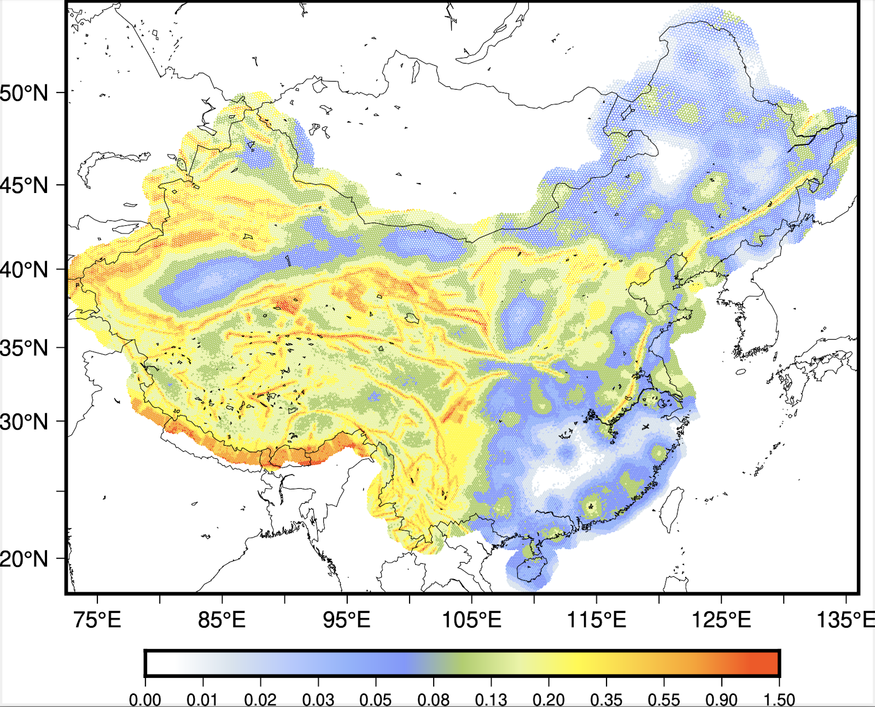
China hazard
Faults from block model results made into seismic sources
Sub- to multi-fault ruptures created with Sherifs
Background seismicity included as well
Notes:
Here is what this looks like when we build the hazard model. This figure shows the 10% exceedance of PGA in 50 years. I don’t have time to get into the details, but basically we take the faults and slip rates from the block model, and use that as an input in the program Sherifs that calculates the rates of sub fault to multifault ruptures as well as off-fault seismicity. We can see that in the rapidly deforming regions in western China and the surroundings, the hazard is localized on these fault systems. However in eastern China where there are few faults and the strain rates are low, historical and instrumental off-fault seismicity has a large impact on hazard.

Slide 10

Thank you!
Please attribute to the GEM Foundation with a link to: https://www.globalquakemodel.org
Except where otherwise noted, this work is licensed under a
Creative Commons Attribution-NonCommercial-NoDerivatives 4.0 International License (CC BY-NC-ND 4.0)
https://creativecommons.org/licenses/by-nc-nd/4.0/
Notes:
You are free to:
Share — copy and redistribute the material in any medium or format
The licensor cannot revoke these freedoms as long as you follow the license terms.
Under the following terms:
Attribution — You must give appropriate credit, provide a link to the license, and indicate if changes were made. You may do so in any reasonable manner, but not in any way that suggests the licensor endorses you or your use.
NonCommercial — You may not use the material for commercial purposes.
NoDerivatives — If you remix, transform, or build upon the material, you may not distribute the modified material.
No additional restrictions — You may not apply legal terms or technological measures that legally restrict others from doing anything the license permits.
Notices:
You do not have to comply with the license for elements of the material in the public domain or where your use is permitted by an applicable exception or limitation.
No warranties are given. The license may not give you all of the permissions necessary for your intended use. For example, other rights such as publicity, privacy, or moral rights may limit how you use the material.

